Slide 1
Radium sorption to iron minerals
Michael Chen, Tiffany Wang, Benjamin Kocar
MIT Department of Civil and Environmental Engineering
ACS National Meeting and Exhibition Boston
August 20th, 2015
Notes:
Good morning, my name is Michael Chen, and I’ll be presenting some results from our lab’s work on radium sorption to iron minerals.

Slide 2

Introduction and objectives
Naturally occurring radium isotopes
Natural hazard/tracer with little human use
Wide range of half lives
3 days – 1600 years
2 oxidation states
Goal: Understand geochemistry for better predictions of transport
This talk: Behavior in static systems
Clock using radium for illumination from en.Wikipedia.org/Radium_dials
Notes:
Radium isotopes are naturally occurring radioactive materials that are generated in the ground surface. While they have seen historic use as a luminescent compound and dubiously safe “medicine,” there is little current anthropogenic use. At present there they represent a natural hazard when brought to the surface by anthropogenic activities such as natural gas extraction or mining operations, and as generators of radon, which can accumulate in buildings with poor ventilation. They also have seen some use recently as natural tracers for groundwater flow. The naturally abundant radium isotopes have a range of half lives from a few days, to 1600 years, presenting both a long term hazard but also a broad range of timers for natural processes. Radium has only two oxidation states, the two plus state and zero valent metal, thus transport is generally simpler, dominated primarily by sorption reactions with minerals. In spite of this simplicity, radium transport remains poorly understood as compared to other contaminants such as Uranium or Arsenic. Our goal is to improve understanding of radium geochemistry in support of building better predictions of radium transport. Here, I will be presenting work around radium behavior is static systems without flow, looking at sorption isotherms, and the impact of oxidation on radium partitioning.

Slide 3
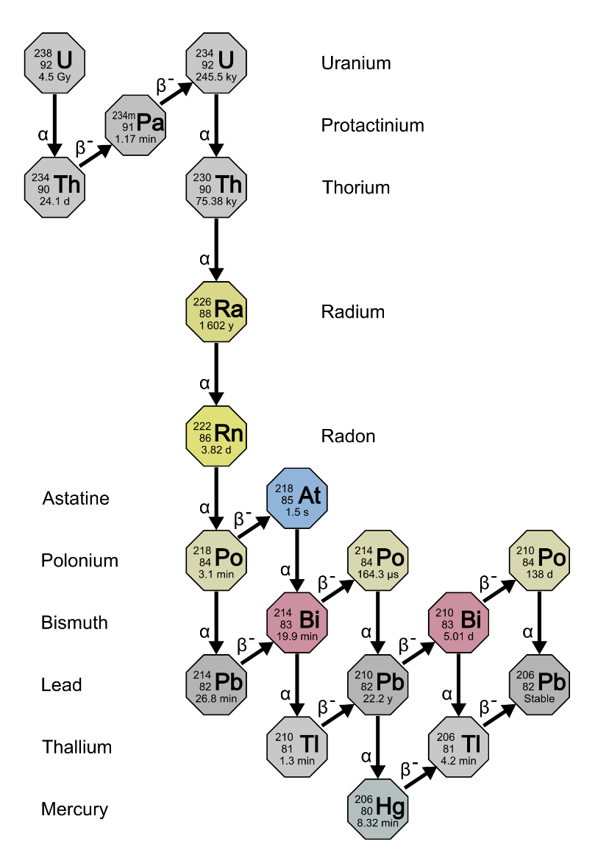
Radium in the environment
Source: ubiquitous parent radionuclides
Activites:
Removal dominated by advection and decay
Extensive adsorption to iron and manganese minerals
Changing environmental conditions affect transport
Salinity
Redox potential
pH
Uranium Series decay taken from en.Wikipedia.org/Decay_chain
Notes:
Environmental radium is generated from the decay of solid uranium and thorium that is well distributed in the ground surface. In regions with low groundwater flux, deep pore waters are enriched with radium isotopes reaching a steady state that matches the relative ratios of the parent products, while shallower regions see groundwater flux that eventually deposits radium into the ocean, where it the isotopes are removed by decay. With strong adsorption retarding transport and exclusive generation in the ground surface, radium is a relatively persistent compound which only sees decrease in the ocean, where decay removes radium from the water column. Radium traditionally is seen as a compound with high retardation factors, owing to strong sorption by oxidized iron and manganese minerals, so transport is expected to be relatively slow compared to other compounds. There are a wide variety of environments containing radium, and often these environments see significant changes in critical environmental parameters including salinity, redox potential, and pH. These changing conditions will drastically affect radium geochemical reactions, and therefore the transport processes at play.

Slide 4
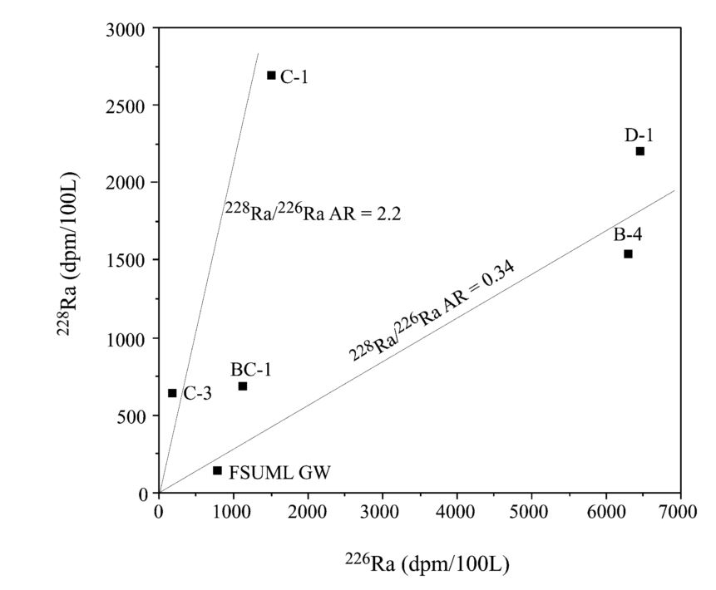
Radium as groundwater flux tracer
Radium isotope mixing model for nearshore system
Source:
Groundwater
Sink:
Decay
Assumes conservative transport of isotopic ratios
Figure from Moore, 2003, illustrating the identification of radium sources for a nearshore system.
Notes:
In recent years, naturally occurring radium has been leveraged as a natural tracer of opportunity. The radium isotope method estimates groundwater flux into the ocean through radium isotope ratios. In the method, groundwater sources are characterized by their isotopic ratio, and then oceanic isotope measurements are matched to those sources through a mixing model. The model assumes conservative radium transport, attributing isotope sources to specific groundwaters and the only sink for isotopes as decay. The figure on the right, which comes from Moore, 2003, illustrates one of the steps of this process. The radium 226 and radium 228 concentrations of oceanic and groundwater samples in an estuarine system are plotted together, revealing two distinct slopes that can be tied to specific groundwater sources of radium.
The estimates by these methods have been matched to a variety of other methods, and is accurate for a region so long as the groundwater sources are all accounted for. Because the method does not resolve groundwater transport however, any fractionation that might occur due to decay, as radium 228 decays through insoluble thorium before decaying into radium 224. This has not historically been a problem for these estimations, but the accuracy and predictive power of these models would be improved with a better understanding of radium geochemical behavior.

Slide 5
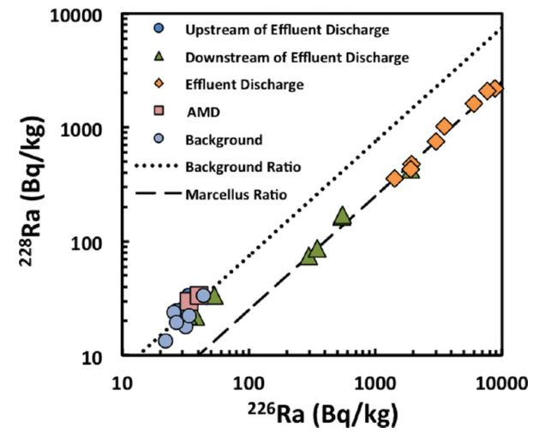
Radium in hydraulic fracturing
Produced water brings radium to surface
Activities:
Alteration in-situ redox state
Treatment/disposal expensive
Co-precipitation with Barium Sulfate
Improper handling can lead to leakage
Potential to mark contamination events
Figure from Warner et al, 2013 of river sediment radium concentrations near a waste water treatment plant
Notes:
One activity where radium presents a major hazard is hydraulic fracturing where radium enriched pore waters are brought to the surface along with extracted natural gas. Fracturing fluids that are injected into these anoxic shales contain significant amounts of oxygen, creating dynamic redox conditions affecting radium activities in produced waters. Activities of radium in produced water exceed established safety limits (around 2 DPM/L), presenting a radioactive hazard to workers and the local ecosystem. Extremely saline produced waters are often either treated on site, where radium is removed by either filtration through manganese oxide filters or by co-precipitation with Barium Sulfate. In cases where treatment is too expensive, the produced water is transported away from sites to be disposed in deep geologic formations. The primary risk of leakage for radium contamination to the surrounding environment occurs before treatment/disposal, when produced water has to be stored on site. Temporary storage ponds and well casings may not necessarily be sealed properly, and produced water can be leaked to the shallow subsurface.
A recent study examining the river sediments near a produced water treatment plant found that river sediments downstream had the same isotopic ratio as materials from the Marcellus shale. The figure here is taken from that work, showing radium 226 and 228 signatures near a treatment facility. Sediments upstream of the facility of very low radium concentrations, but the effluent and downstream sediments have elevated radium concentrations, whose isotopic ratio matches that of the shale they were derived from. The clear difference in isotopic signature suggests that one could trace historic contamination events by monitoring radium isotopes and their ratios. This methodology, however, would only be possible by a solid understanding of radium behavior in the subsurface, with special attention to the impacts of these changing redox conditions on radium partitioning.

Slide 6
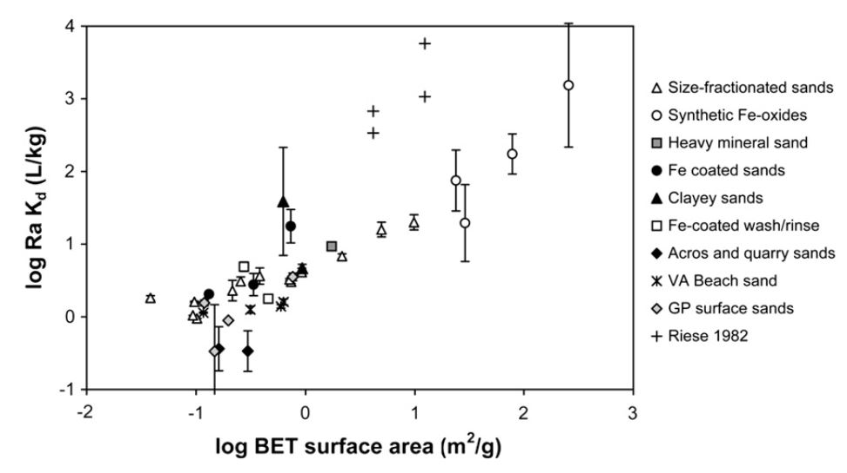
“Historical” data: large variability
DATA SLIDE
Radium sorption to marine sands in seawater from Beck & Cochran, 2013
Notes:
Compared to other contaminants and tracers, there has been relatively sparse characterization of radium adsorption, with significantly differing results. This figure, which shows the log BET surface area of the adsorbent vs the Kd for radium comes from a review of radium adsorption to marine sands from 2013, showing a wide range of linear Kd values for radium sorption to various materials. In particular, I’d like to highlight the large variation of Kd values both within a single type of material, as well as across materials with similar BET surface area. Generally, oxidized iron minerals have stronger sorption, but a mechanistic understanding of this behavior has only recently seen any attention. One of our goals here is to improve that understanding.

Slide 7
Central Questions
What are the dominant minerals retaining radium?
What solution conditions favor radium retention?
How do alterations of mineralogy by redox changes affect retention?

Slide 8
Experimental Work
Sorption Isotherms
Static (no flow) experiments
Redox alteration
pH envelopes
Notes:
Our focus so far has been radium behavior in static conditions, where there is no flow. Here, we’ve performed two categories of experiments: Sorption isotherms, and pH envelopes. These experiments create systems where radium is sorbed to various surfaces. We can then add an oxidant to these systems to induce a change in the minerals present, and observe the subsequent change in radium partitioning.

Slide 9
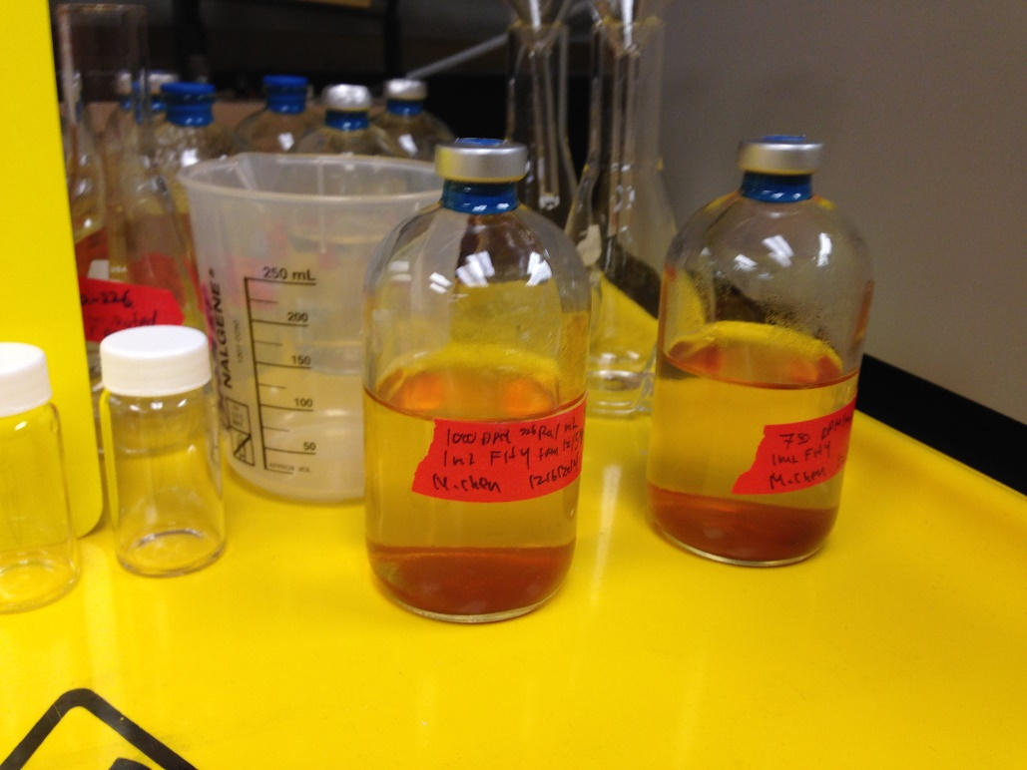
Static Condition Methodology
Synthesized Ferrihydrite, 12 mg in solution
Acid washed, 44-250 um pyrite, 20 mg
24 hour shaking time with 100 mL pH adjusted milliQ water
3000 to 50000 DPM total activity
Radium 226 counted with Scintillation Counter
Two serum vials after a sorption isotherm experiment
Notes:
At present, we have conducted sorption experiments for radium to two minerals: ferrihydrite and pyrite. The ferrihydrite is synthesized by our lab, and aliquots containing 4 mg iron as ferrihydrite are added. Pyrite is sieved to 44-250 um, acid washed to remove oxic coatings, and stored in an anaerobic chamber. In these experiments we add 20 mg of pyrite (which corresponds to 9 mg of Fe as pyrite). These minerals are added to radium containing solutions which are pH adjusted using hydrochloric acid or sodium hydroxide as necessary, with a final volume of 100 mL. Total activities of radium 226 added to these bottles cover from around 3000 DPM to 50000 DPM. After moderate shaking for 24 hours, we note the final pH of the solution, and scintillation count the supernatant. Solid sorption concentrations are then found by mass balance of radium.

Slide 10
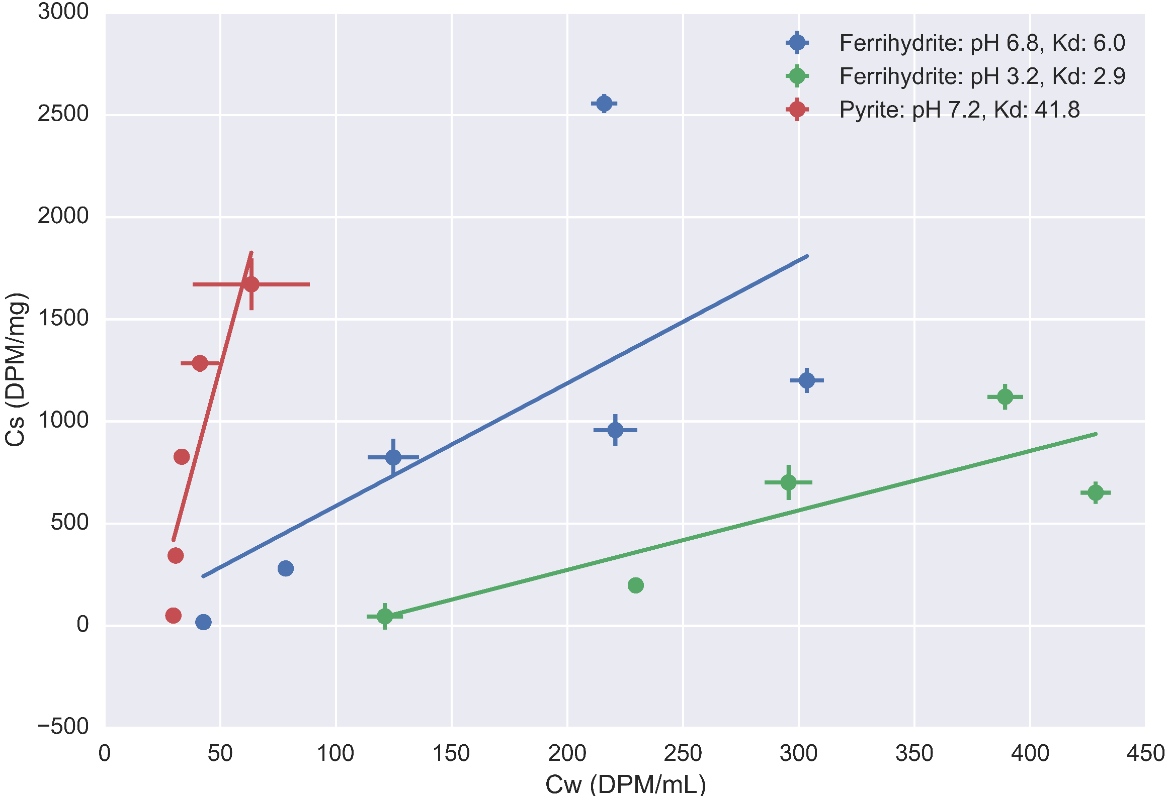
Notes:
Here we plot water activities vs adsorbed solid activities for controlled pH experiments, with data points in triplicate as dots with error lines. Lines are linear regression fits using the scipy package. The blue and green colors represent Ferrihydite, with pH values of 6.8 (plus/minus 0.2), and 3.2 (plus/minus 0.1). The data points and line in red are for pyrite at an average pH of 7.2 (plus/minus 0.2). The fit for the circumneutral isotherms have some spurious points, which we plan to run again to clarify the result. The fits will also be improved as these points are run again.
What is interesting to note here is that pyrite has a similar range of total activities, but has similar or stronger sorption behavior. Pyrite is generally considered a weaker adsorbent than ferrihydrite due to its lower surface area, but this does not seem the case here. One possibility is that the pyrite surface sites have stronger affinity for radium in its plus 2 state as compared to ferrihydrite. The other interesting trend to note is that ferrihydrite has lower adsorption at lower pH values.

Slide 11
Isotherm discussion
Results
Ferrihydrite: Low pH has lower sorption
Pyrite: Stronger adsorption than ferrihydrite at same pH
Data points in need of clarification
Implications
Ferrihydrite normally considered stronger sorbent
Oxidation of pyrite->desorption of sorbed radium?
Need to identify other controlling sorbents

Slide 12
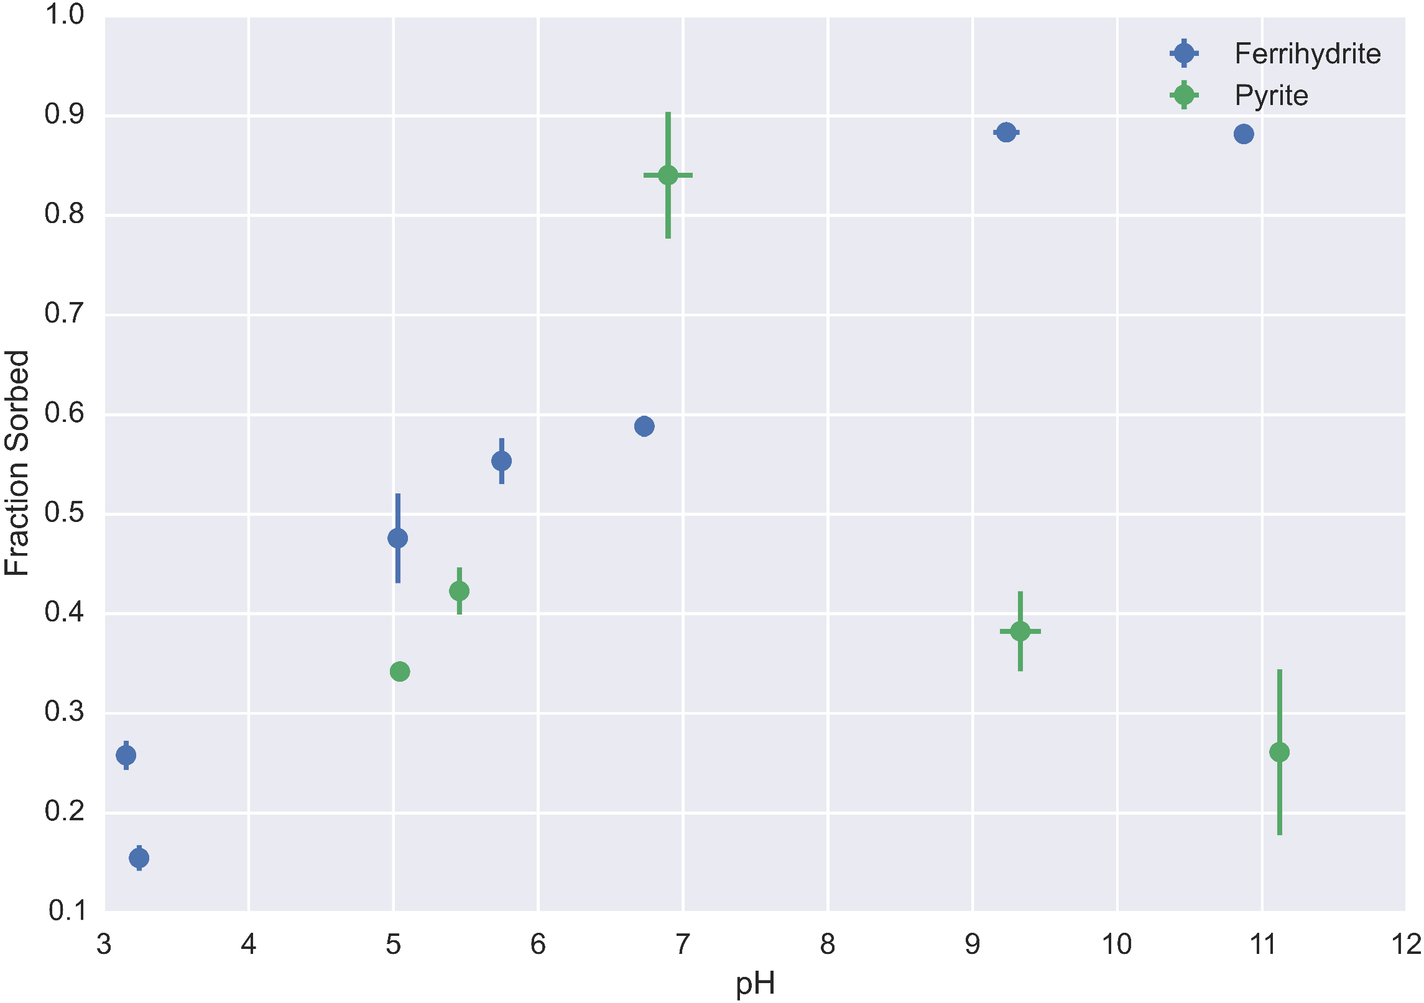
Notes:
This figure shows data for radium adsorption with total activities around 50000 DPM for FHY and 40000 DPM for PYR. pH is on the horizontal axis, and fraction sorbed is on the vertical axis.
The trend we saw in the isotherm data for ferrhydite is maintained here, with ferrihydrite adsorption increasing with increasing pH. However, it reaches a maximum around pH 9. This trend has been found in previous studies of ferrihydrite sorption. In constrast, pyrite behavior is more complex, with minimal adsorption occurring at extreme pH values, and maximal sorption at circumneutral pH. As previously mentioned, some of the data points here are unclear, and may need to be rerun. One reason that pyrite adosprtion decreases with increasing pH, but FHY adsorption increases could be that FHY adsorption is more thermodynamically favorable for radium and ferrihydrite than radium and pyrite at higher pH values. This may be driven by the formation of radium hydroxide complexes.

Slide 13
Discussion
Results
Ferrihydrite:
Increasing adsorption with increasing pH, matching isotherm results
Adsorption peaks out
Pyrite:
Maximal sorption at circumneutral pH
Implications
Control pH to control sorption
Mineral specific behavior

Slide 14

Oxidation Experiment Methodology
Pyrite experiment after shaking period
Removal of supernatant for quantification
Addition of 3% hydrogen peroxide
Shaking for 48 hours with controls
Schematic where a pyrite grain is oxidized, forming oxidized iron coatings and potentially releasing radium from the surface
Notes:
After we ran the experiment that generated the majority of the pH sweep data, we performed a preliminary experiment looking at the impacts of oxidation. We removed 10 mL of solution for radium quantification and final pH measurement. In one set of bottles we added 10 mL of 3% Hydrogen Peroxide. In the other, we left the bottle undisturbed. Both bottles were then shaken for ~60 hours, and then sampled in a similar behavior as before, checking the final pH and radium content of the filtered supernatant.

Slide 15
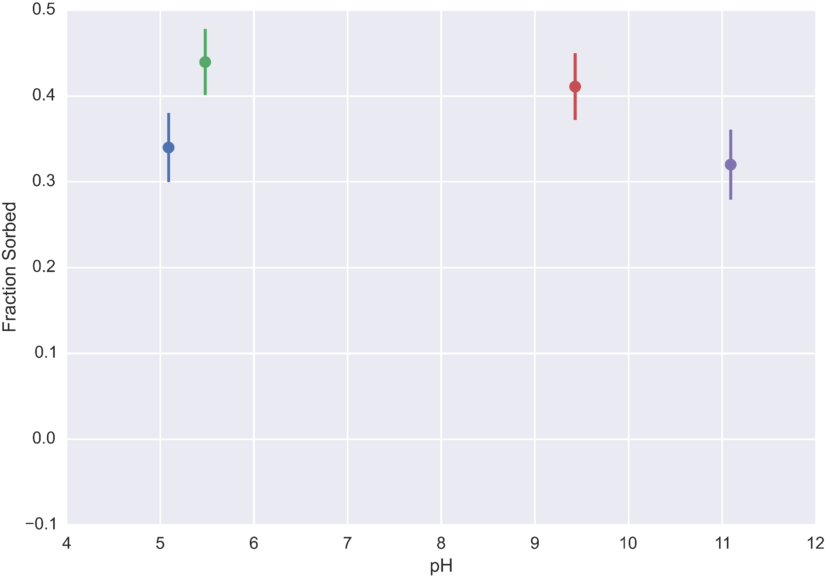
Oxidation Experiment: Before addition of hydrogen peroxide
Notes:
This is the initial data for the oxidation experiment, which are at equilibrium after the pH envelope experiment.

Slide 16
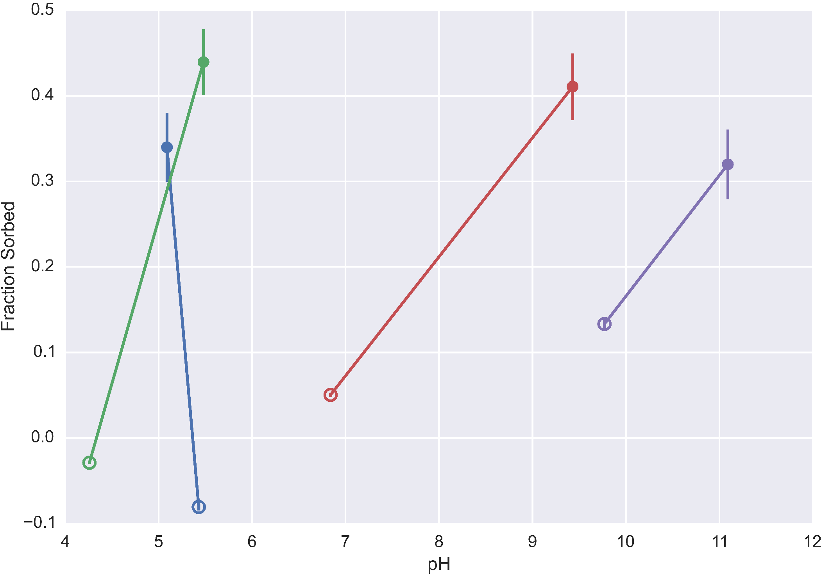
Oxidation Experiment: After hydrogen peroxide addition
Notes:
After the addition of hydrogen peroxide, we see a drastic drop in sorbed radium. We also ran controls for these experiments without any peroxide addition, which had some decrease in radium sorption as well, something which we will be investigating further. We also observe drops in the pH values, which makes sense since oxidation of pyrite generates acid.

Slide 17
Oxidation Experiment: After hydrogen peroxide addition
Radium and Pyrite
Oxidized Pyrite
Notes:
After the addition of hydrogen peroxide, we see a drastic drop in sorbed radium. We also ran controls for these experiments without any peroxide addition, which had some decrease in radium sorption as well, something which we will be investigating further. We also observe drops in the pH values, which makes sense since oxidation of pyrite generates acid.

Slide 18
Discussion
Results
Overall decrease in adsorption in control and experiment
More desorption with oxidant than without
Decrease in pH->change in adsorption, oxidation of pyrite
Implications
Oxic solution can desorb radium from reduced minerals
Ideal retention requires anoxic system at circumneutral pH or oxic system at high pH
Notes:
We clearly see that adsorption of radium in these systems decreases over time, both in the control experiments and in added oxidant experiments.

Slide 19
Conclusions
Quantified pyrite and ferrihydrite sorption behavior
Radium sorbs more extensively to pyrite than ferrihydrite
Minerals have pH dependent behavior
Sensitive partitioning behavior
Strong dependence on mineral
Control solution chemistry to enhance retention
Notes:
In conclusion, we’ve been able to quantity basic trends in pyrite and ferrihydrite sorption of radium, with pyrite seeming to be the stronger sorbent. We also found pyrite has maximal sorption at circumneutral pH values, and FHY has maximal sorption at higher pH values. While the results regarding the pH dependence of sorption are not surprising, the differences between pyrite and ferrihydrite run counter to generally assumed trends, since ferrihydrite has a much higher surface area compared to pyrite. This unexpected result has crucial implications in hydraulic fracturing operations where anoxic pore waters are suddenly supplied with oxygen through hydraulic fracturing fluid. These results suggest though that this behavior could be countered by brine pH to enhance radium sorption. Simple addition of base could help reduce the total load of radioactive material in produced waters, thus reducing the costs and environmental risks associated with hydraulic fracturing.

Slide 20
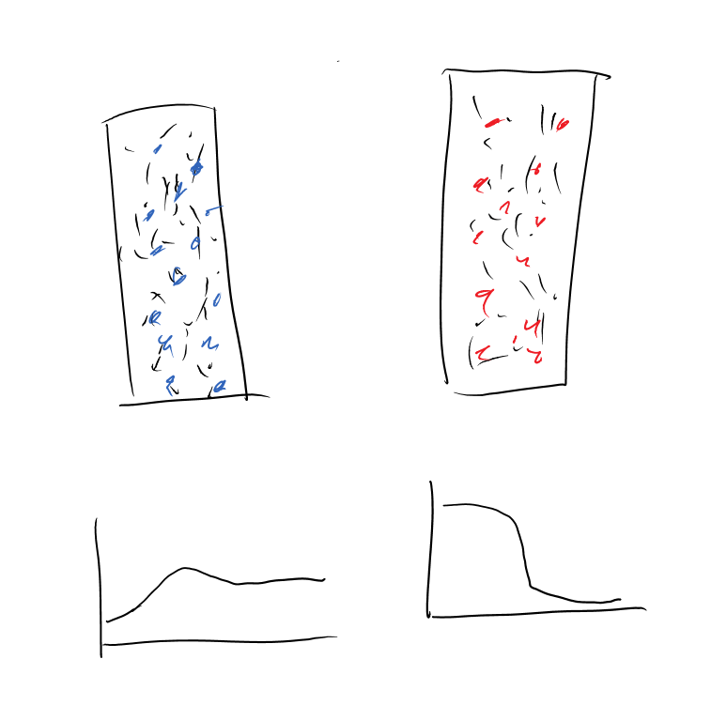
Future work
Ra⁺,+ O₂
Ra²⁺
Iron Oxides
Pyrite
Further sorption experiments (salinity, minerals)
Transport experiments with columns
Impact of dynamic solution conditions
Ra²⁺
Time
Notes:
For future work, we plan to expand more the range of solutions and minerals we cover, specifically addressing the impacts of increasing salinity (up toward high salinity fracking brine level), and different minerals including goethite, and other common minerals (illite, quartz sand). The next step for this work is to look at how these static behaviors change in the presence of flow through columns. Lastly, we will further explore the impacts of dynamically varying conditions in solution, particularly focusing on the impact of changes in oxidation state, and changes in salinity. These experiments will closely mirror many of the real systems that radium encounters, where anoxic waters interact with oxic waters or estuarine regions.
The image on the right is some very preliminary work, where we induce precipitation of oxidized minerals in a idealized porous media, and image the result using standard microscopy techniques. The uneven distribution of these solids suggest that material transport linked to those solids (cough cough Radium) is a highly heterogeneous process that is impacted by flow conditions.

Slide 21
Acknowledgements
MIT Radiation Protection Office
Roman Stocker, Roberto Rusconi
Kocar Lab
SSRL

Slide 22
Works Cited
Beck, A. J., & Cochran, M. a. (2013). Controls on solid-solution partitioning of radium in saturated marine sands. Marine Chemistry, 156, 38–48. doi:10.1016/j.marchem.2013.01.008
Moore, W. S. (2003). Sources and fluxes of submarine groundwater discharge delineated by radium isotopes. Biogeochemistry, 66(1), 75–93. doi:10.1023/B:BIOG.0000006065.77764.a0
Warner, N. R., Christie, C. a., Jackson, R. B., & Vengosh, A. (2013). Impacts of shale gas wastewater disposal on water quality in Western Pennsylvania. Environmental Science and Technology, 47, 11849–11857. doi:10.1021/es402165b
Wikipedia. (2014, November 21). Retrieved from https://en.wikipedia.org/

